Slide 1

ASP.NET Web Forms and VS vNext : Do more with less
Pranav Rastogi
SDET
Level: Intermediate

Slide 2
What will you get from this talk
Do more with less
See new features
How to integrate them into your existing application
Notes:
-These changes are small and combined together can make you highly productive web developers
-Questions @end

Slide 3


Slide 4
What we will look at
Solution Compatibility b/w VS2010 & VS11
ASP.NET Web Forms
Web Standards Support
Optimization
Page Inspector

Slide 5
We HEARD YOU!!!
ASP.NET User Voice
Most of the features are code complete
And all that is just half of VS11 goodness

Slide 6
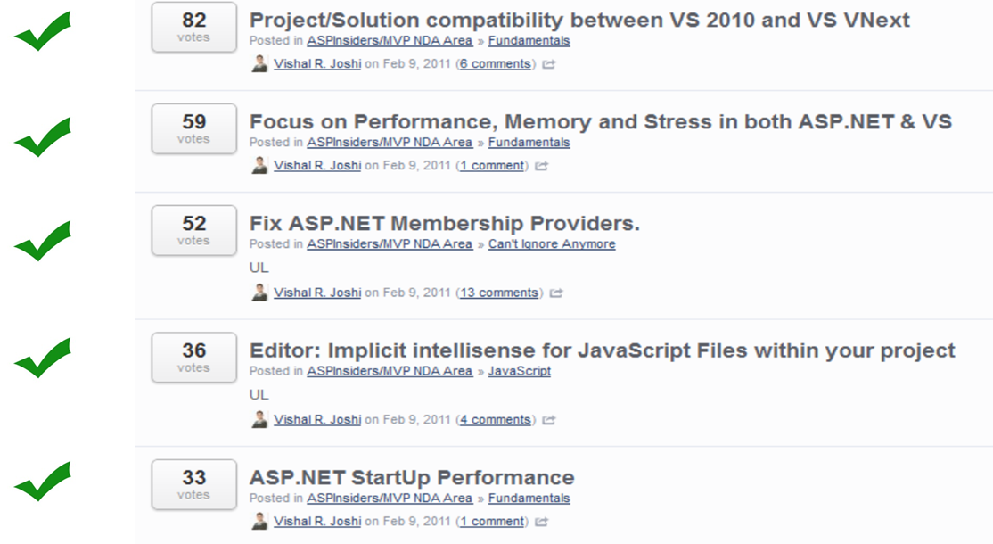

Slide 7
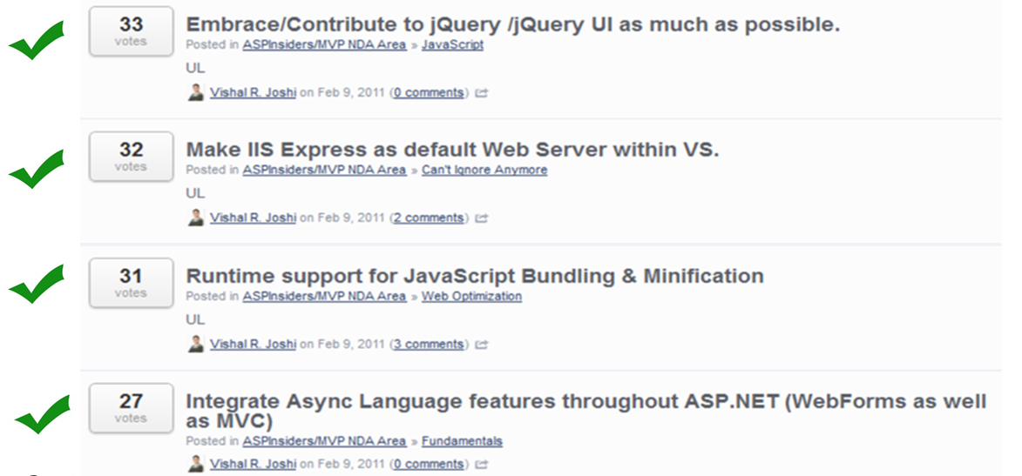

Slide 8
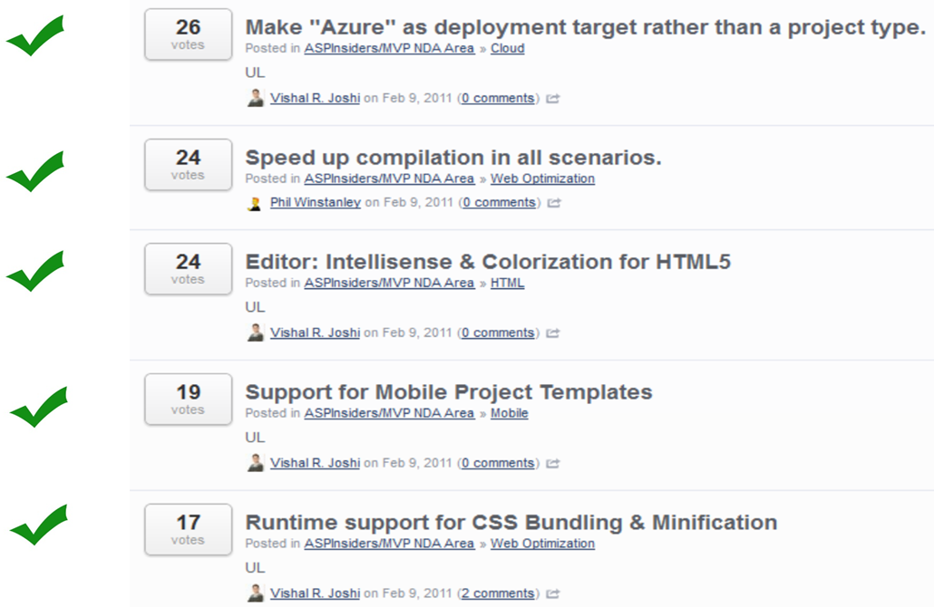

Slide 9
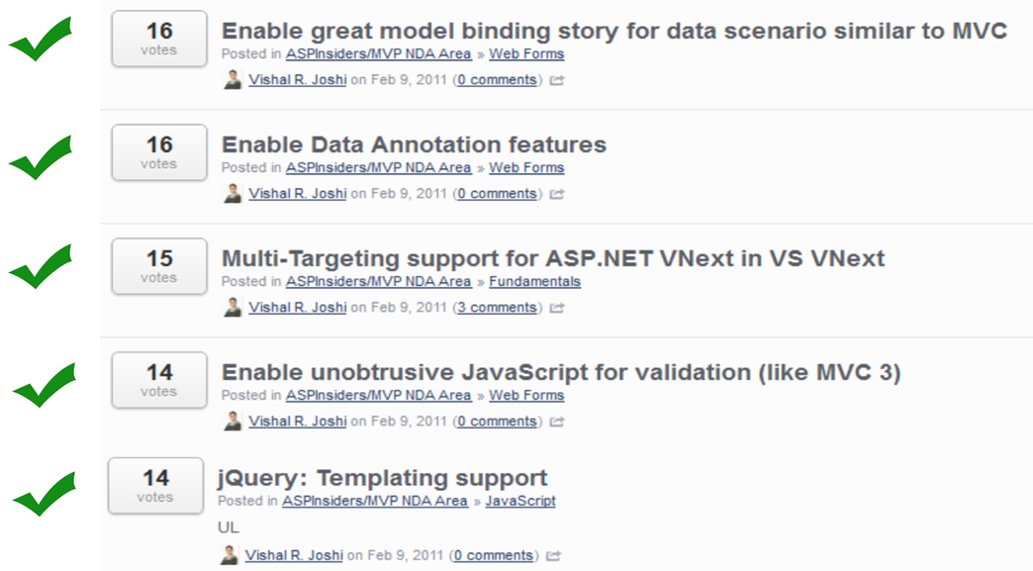

Slide 10
Web Forms
“”
Events
Filtering
User Controls
Intellisense
Tag Correction
Indenting
Model Binding
Request Validation
Anti XSS
Templated Data Controls

Slide 11

Do more with less!!!

Slide 12



Solution Compatibility

Slide 13
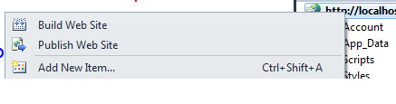
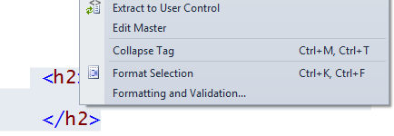
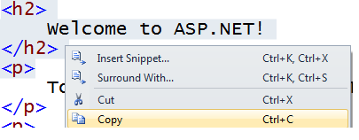


User Control – Before & After

Slide 14
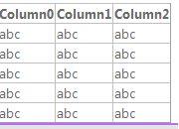

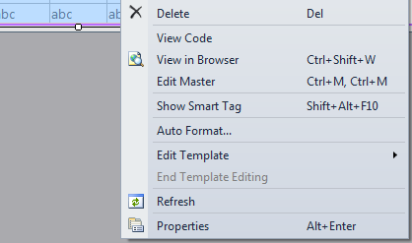


Event Generation - Before & After

Slide 15
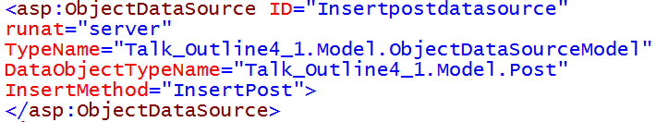
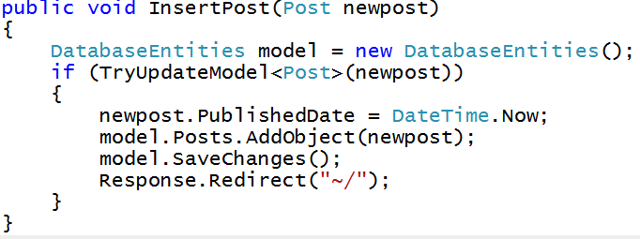
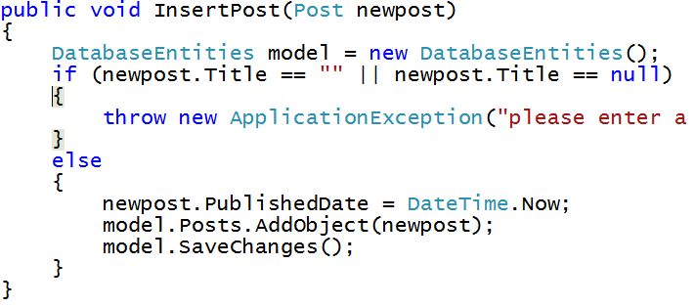
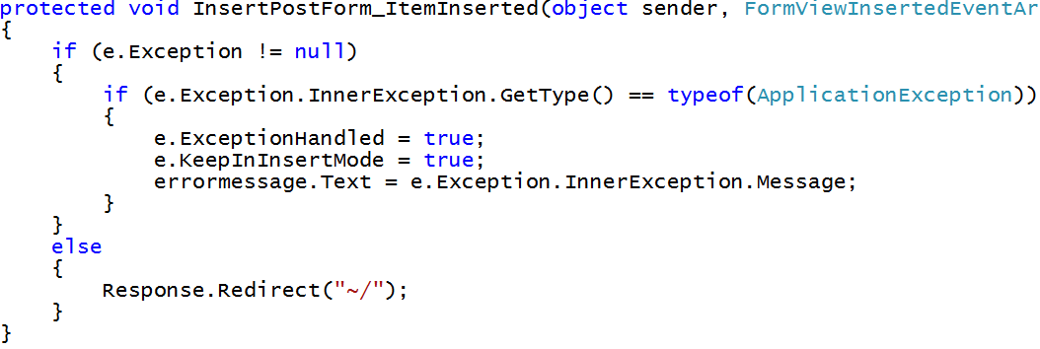
Inserting -Before & After

Slide 16
And Others…
Request Validation
Templated DataControls
Encoding
Tag Completion
Attribute Intellisense
Filtering
Smart Tasks In Source

Slide 17
Web Standards & Optimization
HTML5
JavaScript
CSS3
Bundling & Minification

Slide 18
Do more with less!!!

Slide 19
Web Standards & Optimization
HTML5
Snippets / DOCTYPE
JavaScript
Goto / Reference
CSS3
Color Picker / snippets
Bundling & Minification
Minify CSS/JS

Slide 20
Page Inspector

Slide 21




pain
Publish
HTTP
Code
Live DOM
(HTML)
CSS
JS
Server
Client
Aspx
Masterpage
Usercontrol
HTML
.js
CSS

Slide 22
Do more with less!!!

Slide 24
Links
http://blogs.msdn.com/pranav_rastogi/
Visual Studio 11 Developer Preview
Email: pranavra@microsoft.com
Twitter @rustd
W20 NuGet: Add Reference | Awesome
T6 Bigger, Faster, Stronger: Optimizing ASP.NET 4 and 4.5 Applications

